Slide 1
Team-Building Debrief
TEAM 2

Slide 2

The Topic
Improving Communications within a team

Slide 3
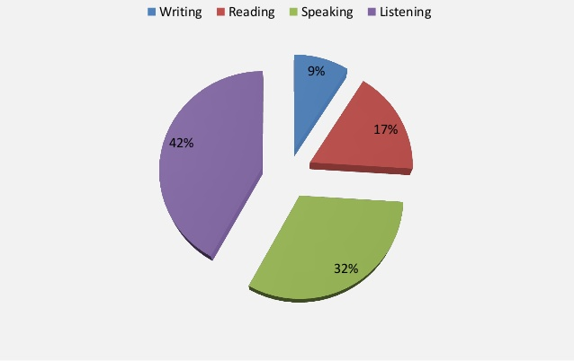
Background Research

Slide 4

The Activity:
A Piece of Paper
The leader in the group was given a piece of paper with instructions and everyone else received a blank piece of paper. The leader announced to the group a sequence of instructions.

Slide 5
Key Learning Points
Key Point 1: Similar Instructions, Different Outcomes
Key Point 2: Importance of Communications
Key Point 3: Improvement of Trust among Teammates
Key Point 4: Benefits to listening

Slide 6
Key Learning Point #1 (Similar Instructions, Different Outcomes)
Even though everyone received the same instructions, their papers do not look identical and may even look quite different.
In real life, we will receive many instructions from our supervisors or project leaders. It is important to remember and review all the instructions carefully and at the same time acknowledge the outcome that is required.
It is important to note these requirements because what people communicate might not translate exactly to what they want done.

Slide 7
Key Learning Point #2 (Importance of Communications)
“Effective Communication is a building block of successful organizations”
Good Communication...
allows us to express our thoughts/ideals to others.
allows a structured & constant flow of information within a group/organization
Prevents mistakes/errors due to miscommunication (tasks/etc)
Overall - It helps to build a innovative and effective team.

Slide 8
Key Learning Point #3 (Improvement of Trust among Teammates)
As communication between team members progresses, the trust and bond among them improves as well.
In future projects where teamwork is needed and information is required to be passed around among members, it can be done much faster knowing the responsibilities and roles of each member.
As a result, the stress levels in the working environment of an office setting, for example, could be minimized.

Slide 9
Key Learning Point #4
(Benefits of listening)
Good communication among team members greatly increases productivity. Additionally, good communication allows employees to feel clear on what their assignments are.
Everyone appreciates good communication. It produces a healthy work environment.
Most conflicts are caused by misunderstood communication. When you turn out to be an effective communicator, you can solve conflict and create harmony by bridging the communication gaps that create conflict.
Effective communication gives clarity in order to stay away from any confusion.

Slide 10
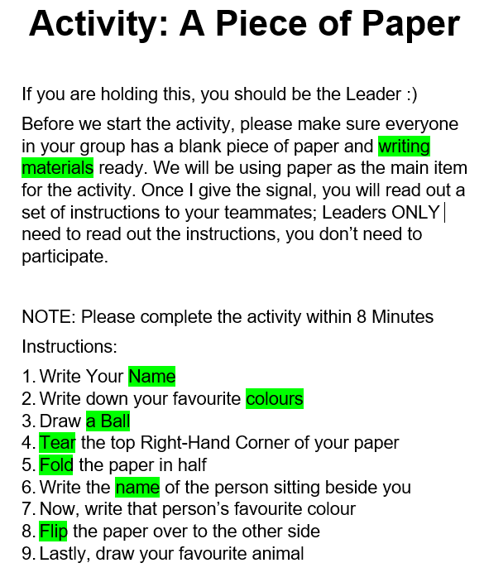

Slide 11
Conclusion
Hence, in conclusion…
The main objective of this activity was to emphasize on the benefits/negative impacts caused by good/bad communication.
In most scenarios, conflicts/problems can be resolved via good communication (which improves teamwork as well)
Effective communication can also maintain relationships
It also facilitates innovation, when everyone feel comfortable in openly communicating.

Slide 12
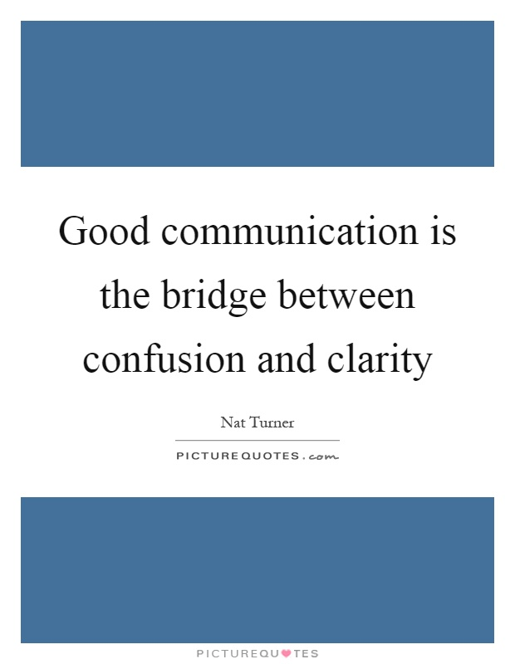

Slide 13
THANK YOU!

